Slide 1
Governor of water Turbine

Slide 2
Contents
Introduction
Examples
Types
Characteristics
Function of WTG
Types of WTG
Qualities of G
Principle elements of OPG
Outlines of OPG
Working of OPG

Slide 3
HUMAN GOVERNOR OPERATION
SYSTEM
TG
X
~
GOVERNOR

Slide 4
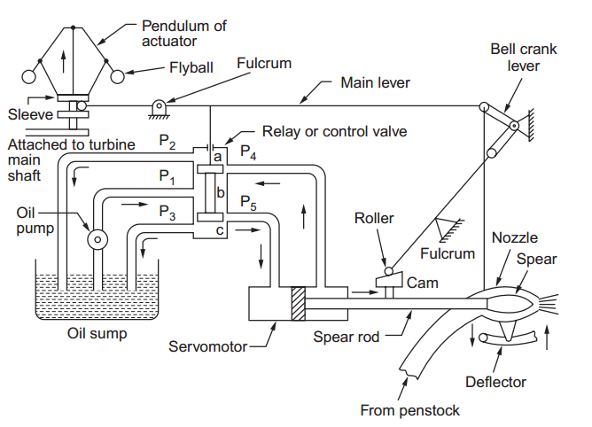

Slide 5
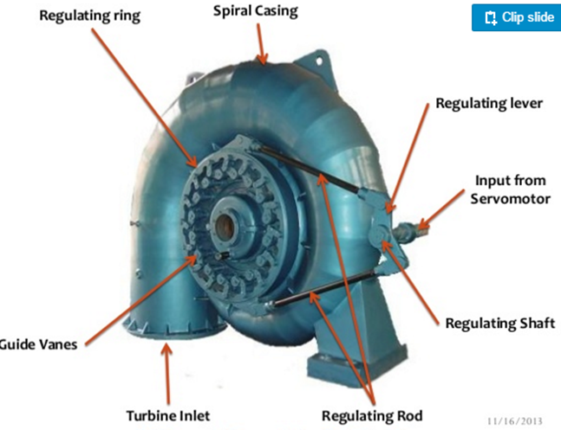
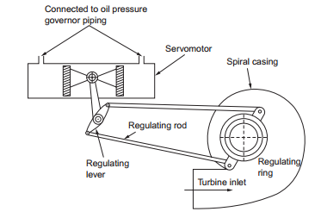

Slide 6
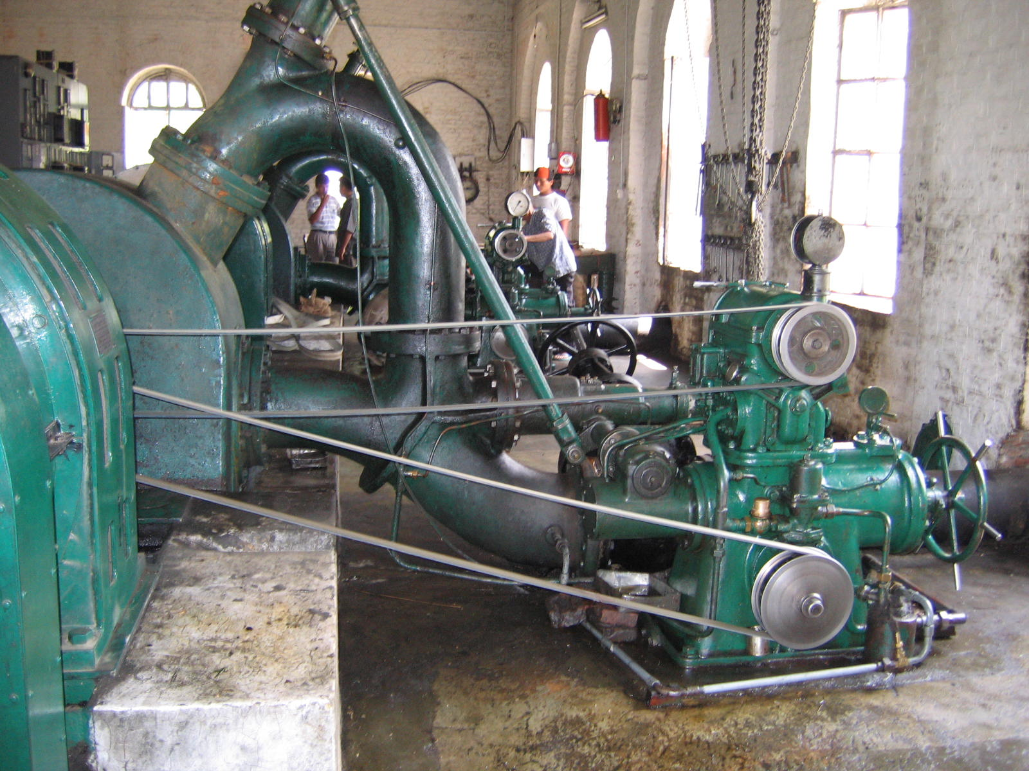

Slide 7
Introduction
Regulation of speed
To maintain a constant speed when load on the turbine fluctuates
Do by controlling the rate of flow of liquid leading to the runner

Slide 8
Examples
Pelton Turbine : close or open the needle valve
Francis Turbine: close or open the guide vanes, wicket gates
Kaplan Turbine: close or open the wicket gates and moves the runner blades
Diesel engine: regulating the fuel supply
Steam turbine, steam engine: controlling the steam pressure
Alternator runs at constant speed to generate constant frequency and voltage, so as load fluctuates speed must be constant.

Slide 9
Types
Small centrifugal governor in diesel engine
Strong governors, eg. Oil pressure governor

Slide 10
Characteristics
Quick action
Water hammering
To keep speed rise of runner and pressure rise in pipe within limits
There are safety drives like deflector in P/T,
There are safety dives like relief valve in reaction /T

Slide 11
Function of WTG
Control the speed of Turbine and match it to the HES for synchronizing.
Maintain desire f and Voltage.
Set the amount of load a Turbine unit has to carry.
Helps starting and shutting.

Slide 12
Types of WTG
The mechanism may operate mechanically, electrically, fluid pressure
Mechanical governors :
small duty : ball and spring G, electric brake G
heavy duty: oil pressure G

Slide 13
Qualities of Governor
1. Sensitiveness:
It is the ratio of mean speed of action to the difference between the max and min speed.
It is the alteration of position of G which is caused by the smallest increase or decrease in speed at any turbine gate opening.
2. Stability
The stable G helps the gate of WTG to come to their proper position with the least possible oscillation.

Slide 14
Qualities of Governor
3. Rapidity of action
If the load increase G’s action to the quick open the gate.
If the load decrease G’s action to the quick close the gate.
This cause pressure fluctuation problems, hence need slow action enough to maintain the operations.
So need heavy fly wheel.

Slide 15
Qualities of Governor
4. Isochronism
The G is said Isochronism if , neglecting friction, the equilibrium speed is same for all radii of balls.
This is possible if the G is infinitely sensitive and the Governor always flies to one or other extreme positions.
5. Hunting or Racing
The G is said if the G has periodic speed fluctuation with steady load.
This happens when the G is too sensitive.

Slide 16
Qualities of Governor
6. Capacity
It is the force required to move the turbine gate servomotor, blade servomotor etc.
7. Speed Regulation
The speed variation caused by sudden increase of full or partial load could be returned back to normal speed, immediately.
8. Regulating time or G’s time
It is a time in sec required to move the Turbine gate from closed to open position or vice versa.
5 sec for long pen-stock and 3 sec for short pen-stock.

Slide 17
Principle elements of OPG
1. Speed responsive element:
Pendulum and drive of pendulum
2. Power element:
Servomotor, Distributor or relay valve, Pressured oil supply unit
3. Stabilizing or compensating element:
Dash pot, Pilot valve
4. Other:
Starting and stopping Gears, Safety device, Load limiting device, Speeder changer, Hydraulic return motion gear etc.

Slide 18
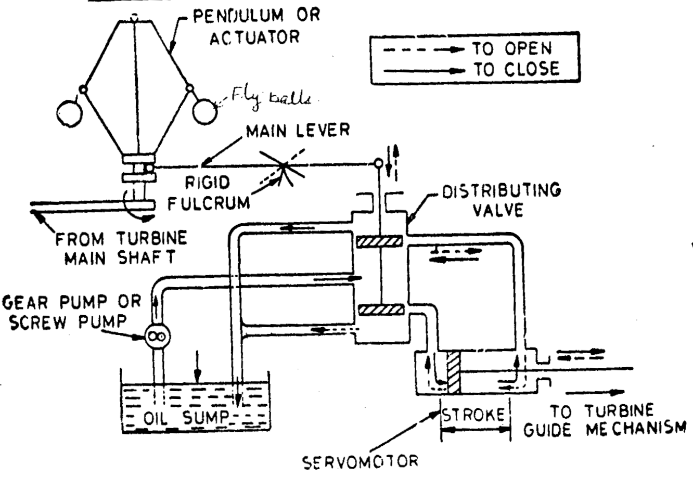
Speed responsive
Power
Stabilizing
Dash pot or Pilot valve
Drive of pendulum
Pressured oil supply unit

Slide 19
Parts and functions of OPG
1. Servomotor or relay cylinder:
To transmit power to turbine gate through suitable mechanisms
Consists of a piston cylinder, moves by action of oil pressure for large 2 cylinders
Use hand wheel to start the unit when automatic G is not equipped.

Slide 20
Parts and functions of OPG
2. Relay or distributing valve:
To controls the oil flow under pressure to either direction of Servomotor cylinder for open or close of turbine positions.
It is a slide valve of piston type.
Distributor or Relay valve is controlled by pilot valve and fulcrum which is controlled by fly ball.

Slide 21
Parts and functions of OPG
3. Actuator or pendulum:
It functions by centrifugal action and driven from turbine main shaft.
It is usually a fly ball mechanism, which responds quickly to speed variation.
4. Dash pot or Pilot valve:
It applies the motion of pendulum fly ball is stabilised and transmitted to the Distributor .
It is Stabilizing or compensating elements.
It damp out the sudden large variation of open-close of the fly ball.

Slide 22
Parts and functions of OPG
5. Pressure oil supply:
It includes a pumping units and supply oil to Distributor.
Pumping units are [rotary ( gear or screw pump], plunger pump, an oil sump tank pressure tank with suitable valves and pipe.
Oil pressure 10 – 20 kg/cm².
In some cases may be 2 gear pumps smaller unit supplies oil to counter act gradual load fluctuation and larger unit for sudden load fluctuation.

Slide 23
Parts and functions of OPG
6. Casing:
It enclose all the parts and also serves as oil sump.
7. Governor driving mechanism:
The centrifugal G and rotary gear pump are driven by the turbine main shaft through belts or gears.
In some modern G electronic/ electric motor and alternator respond the fluctuation of frequency and voltage caused by the variation of the main unit.

Slide 24
Thank you

Slide 25
Oil pressure Governor

Slide 26
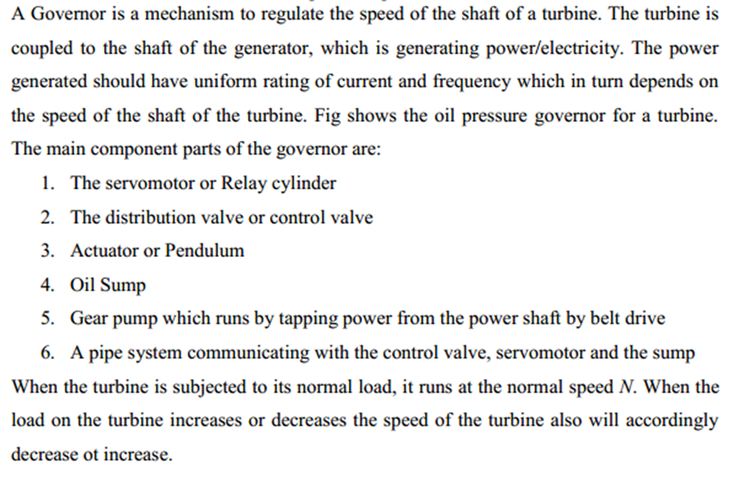
What is Hydraulic Governor?

Slide 27
